Slide 1
GUN VIOLENCE IN THE US: FROM 2013 - 2018
RAYMOND NORMESHIE

Slide 2
AGENDA
CONCLUSION
Conclusion based on set Goal
INTRODUCTION
Project Description
DATA EXPLORATION
Data Quality Assessment
INSIGHTS
Analysis & Visualizations
Project Goal
Data cleaning & Preprocessing
.

Slide 3
INTRODUCTION
PROJECT DESCRIPTION
This project is basically about Gun violence in the United States of America. It involves dataset gathered on incidence of death and injury of tens and thousands of people annually from the various states and cities or county from the year 2013 to 2018. The main objective of this project is to carry-out an EDA to enable me answer some questions with the dataset and also bring out some hidden insights from the dataset.
PROJECT GOAL
To Determine which State and City the Gun Violence Impacted the most and in which Year.

Slide 4
DATA EXPLORATION
DATA QUALITY ASSESSMENT
The dataset was explored with the aid of determining missing values, accuracy of field values and presence of duplicates. There were missing values for which some were resolved by complete removal and filling-in, however there were no duplicates and some variables also weren’t having the right datatype as expected.
DATA CLEANING AND PREPROCESSING
some variables like sources, source_url, incident_url and others were dropped from the analysis.
The date variable was converted to datetime and then separated into year and month column for easy analysis.
Introduced a new column called total_impact for analysis.
Place some supporting images or text here

Slide 5
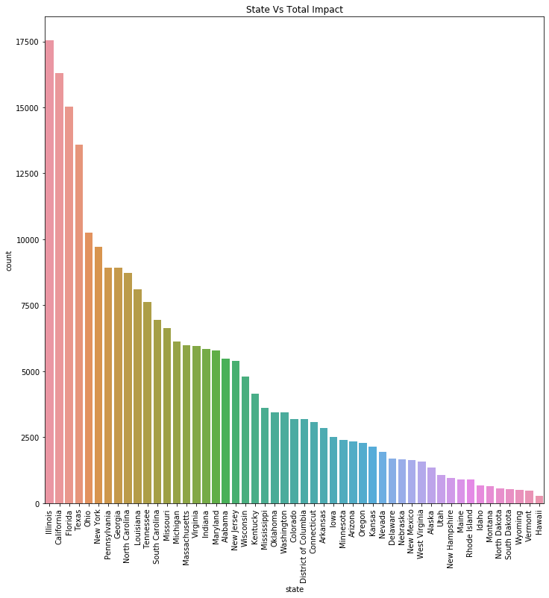
ANALYSIS AND VISUALIZATIONS Most Impacted State It can also be seen that following states namely; Illinois, Carlifonia,Florida and Texas were impacted the most during the gun violence in the US. That is when total number of killings and injuries were combined, they came out to be cities that were affected the most during the gun violence.
INSIGHTS

Slide 6
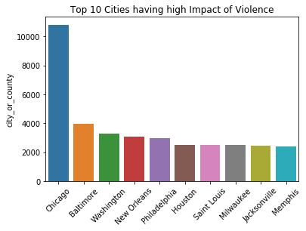
ANALYSIS AND VISUALIZATIONS Most Impacted City or County Also, cities like the Chicago, Baltimore, and Washington were also affected the most during the gun violence in the US.
INSIGHTS

Slide 7
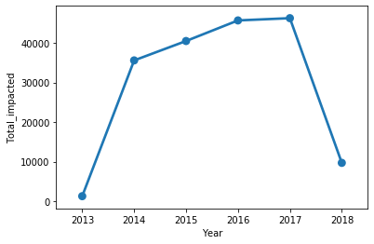
ANALYSIS AND VISUALIZATIONS Year with Most Impact The year 2017 recorded the most incidence occurring due to the gun violence followed by 2016. i.e.. we see the highest number of killings and injuries occurring during this year.
INSIGHTS

Slide 8
CONCLUSION
The year 2017 recorded the most incidence occuring due to the gun violence followed by 2016. i.e.. we see the highest number of killings and injuries occuring during this year.
It can also be seen that following states namely; Illinois, Carlifonia,Florida and Texas were impacted the most during the gun violence in the US. That is when total number of killings and injuries were combined, they came out to be cities that were affected the most during the gun violence.
Also, cities like the Chicago, Baltimore, and Washington were also affected the most during the gun violence in the US.

Slide 9
APPENDIX
https://www.kaggle.com/shivamb/deep-exploration-of-gun-violence-in-us
https://stackoverflow.com/questions/16176996/keep-only-date-part-when-using-pandas-to-datetime
https://stackoverflow.com/questions/44774151/how-to-group-data-and-plot-line-graphs
https://www.kaggle.com/jameslko/gun-violence-data

Slide 10


